Slide 1
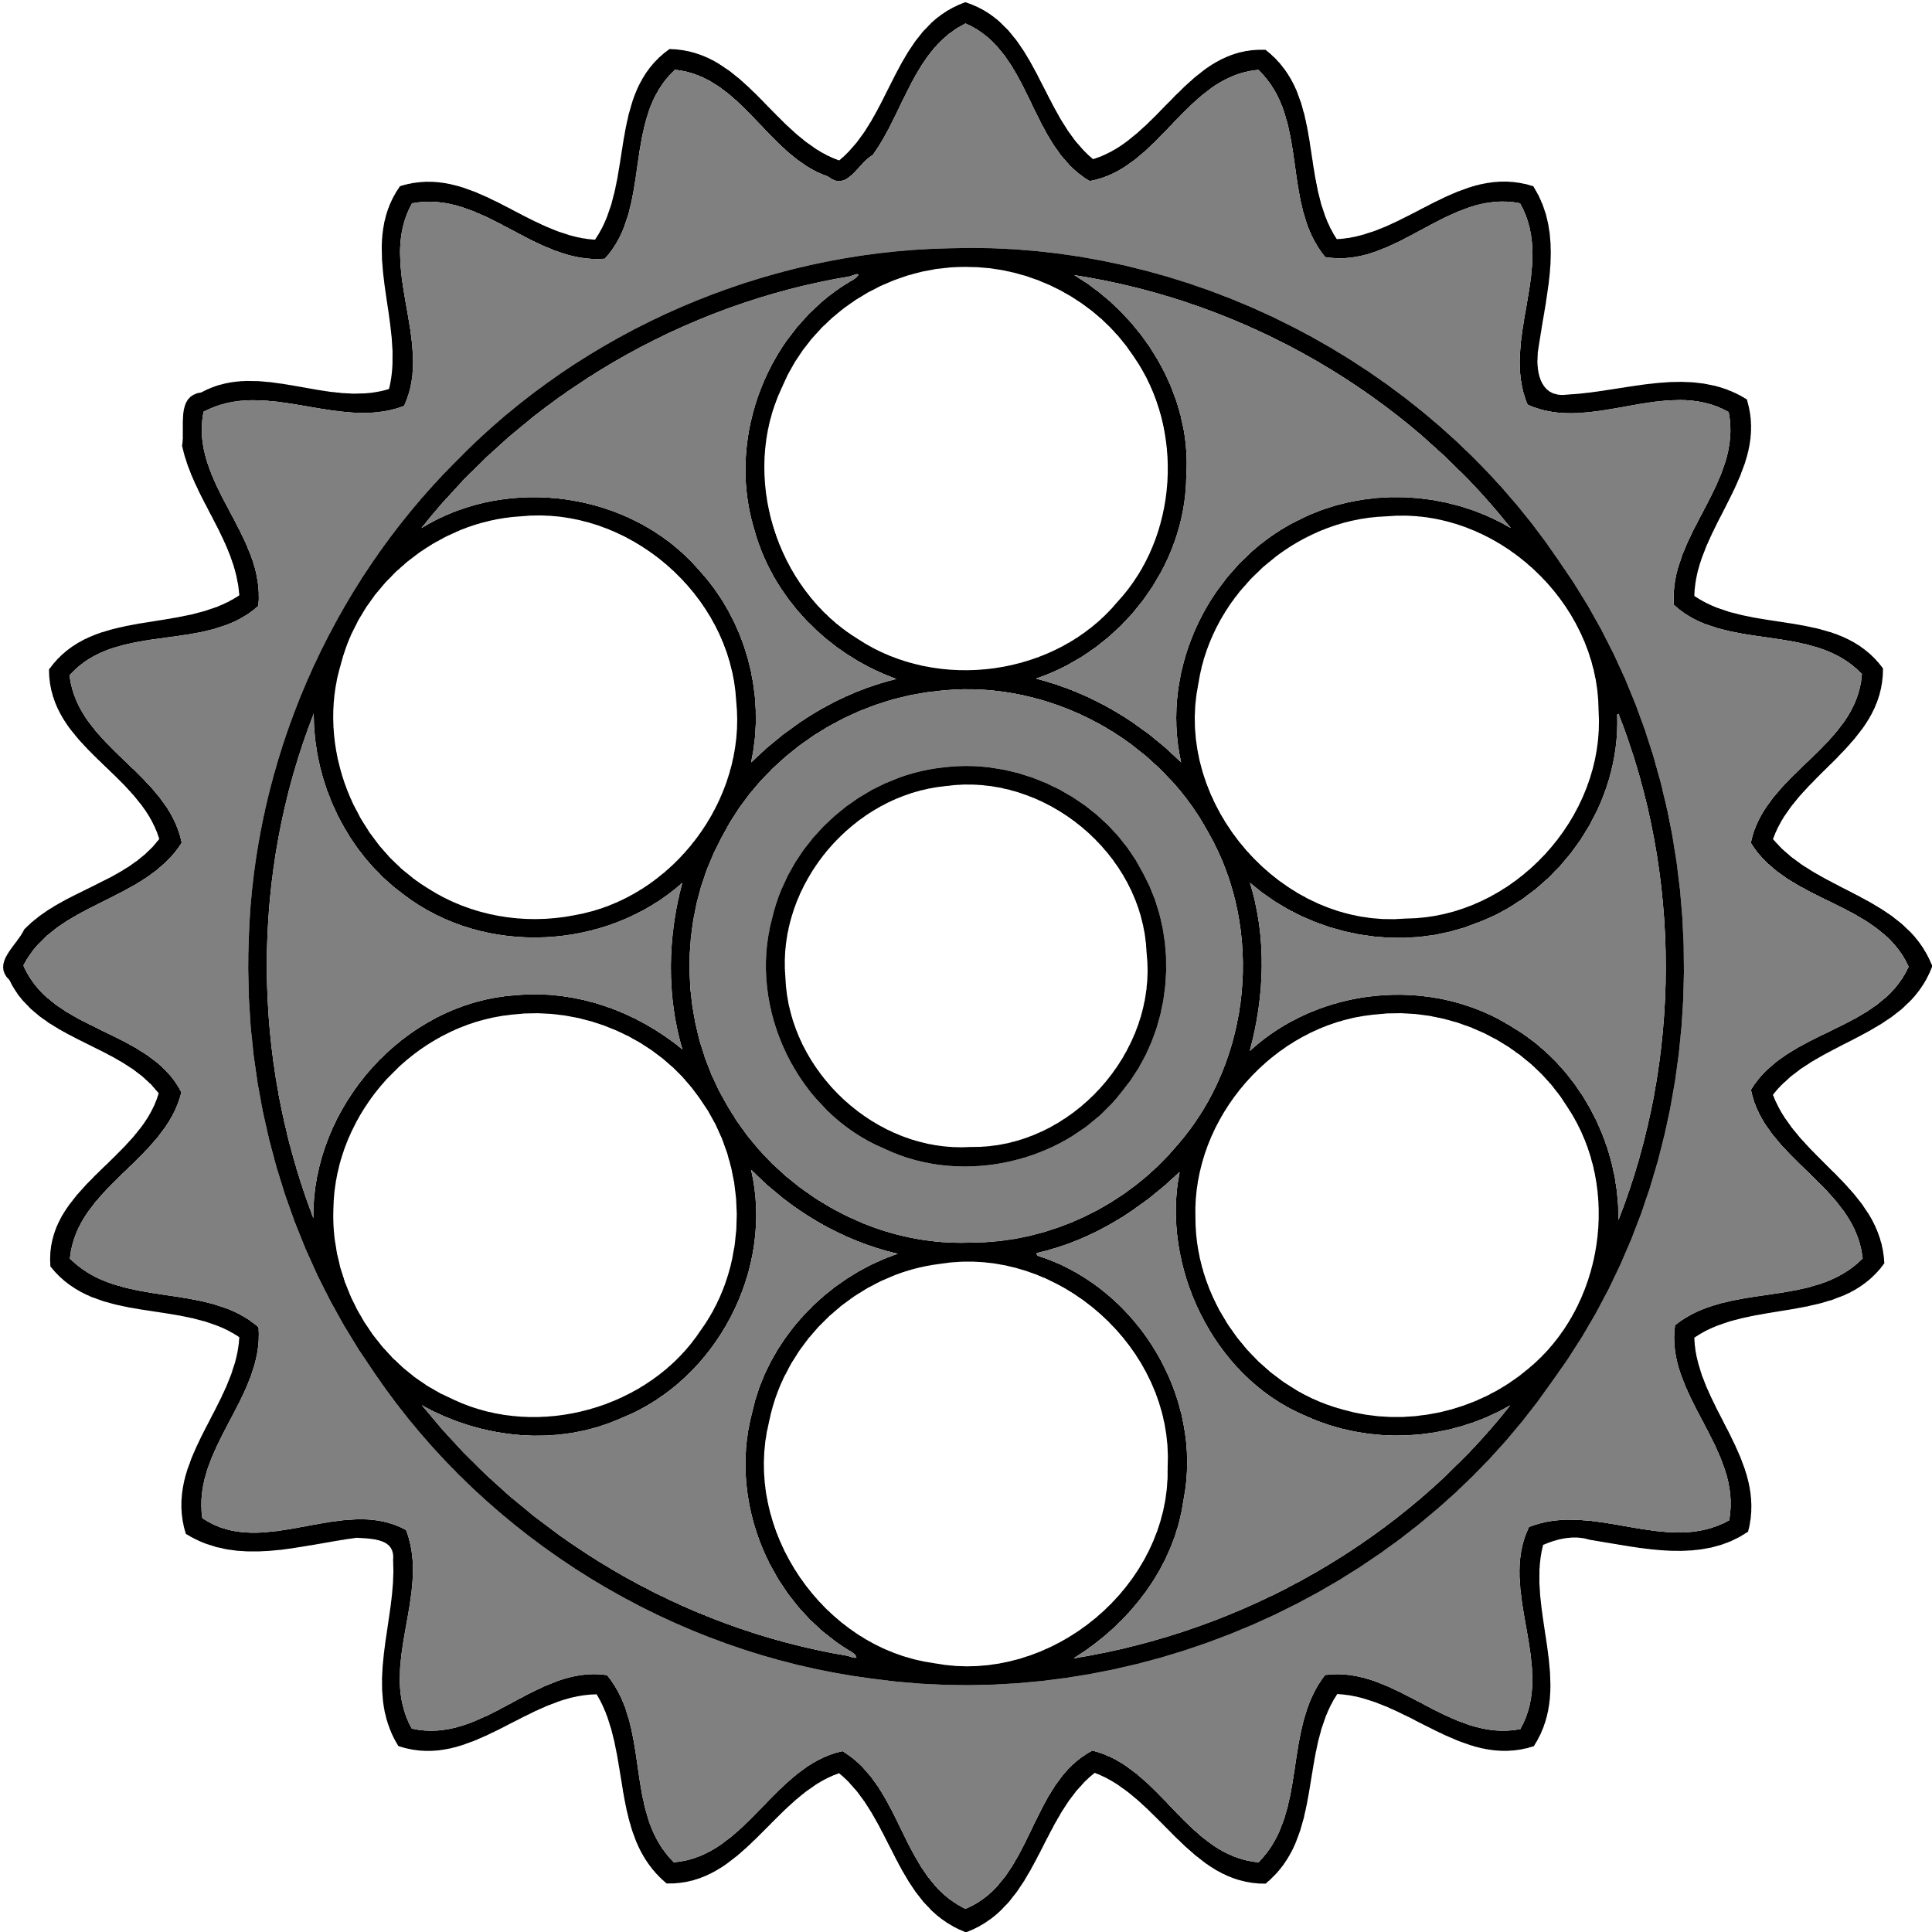

Software Engineering
“What one programmer can do in one month, two programmers can do in two months.”
– Fred Brooks

Slide 2

What is Software Engineering?
Software engineering is the process by which we build software systems…
Social Interaction
Design
Development
Iteration
Release
Support
Maintenance
Software engineering is not just programming; it lasts for the software’s lifetime.

Slide 3
Flow Charts
Stuff goes here.
Asdf

Slide 4
Pseudocode
Stuff goes here.
asdfasdf

Slide 5
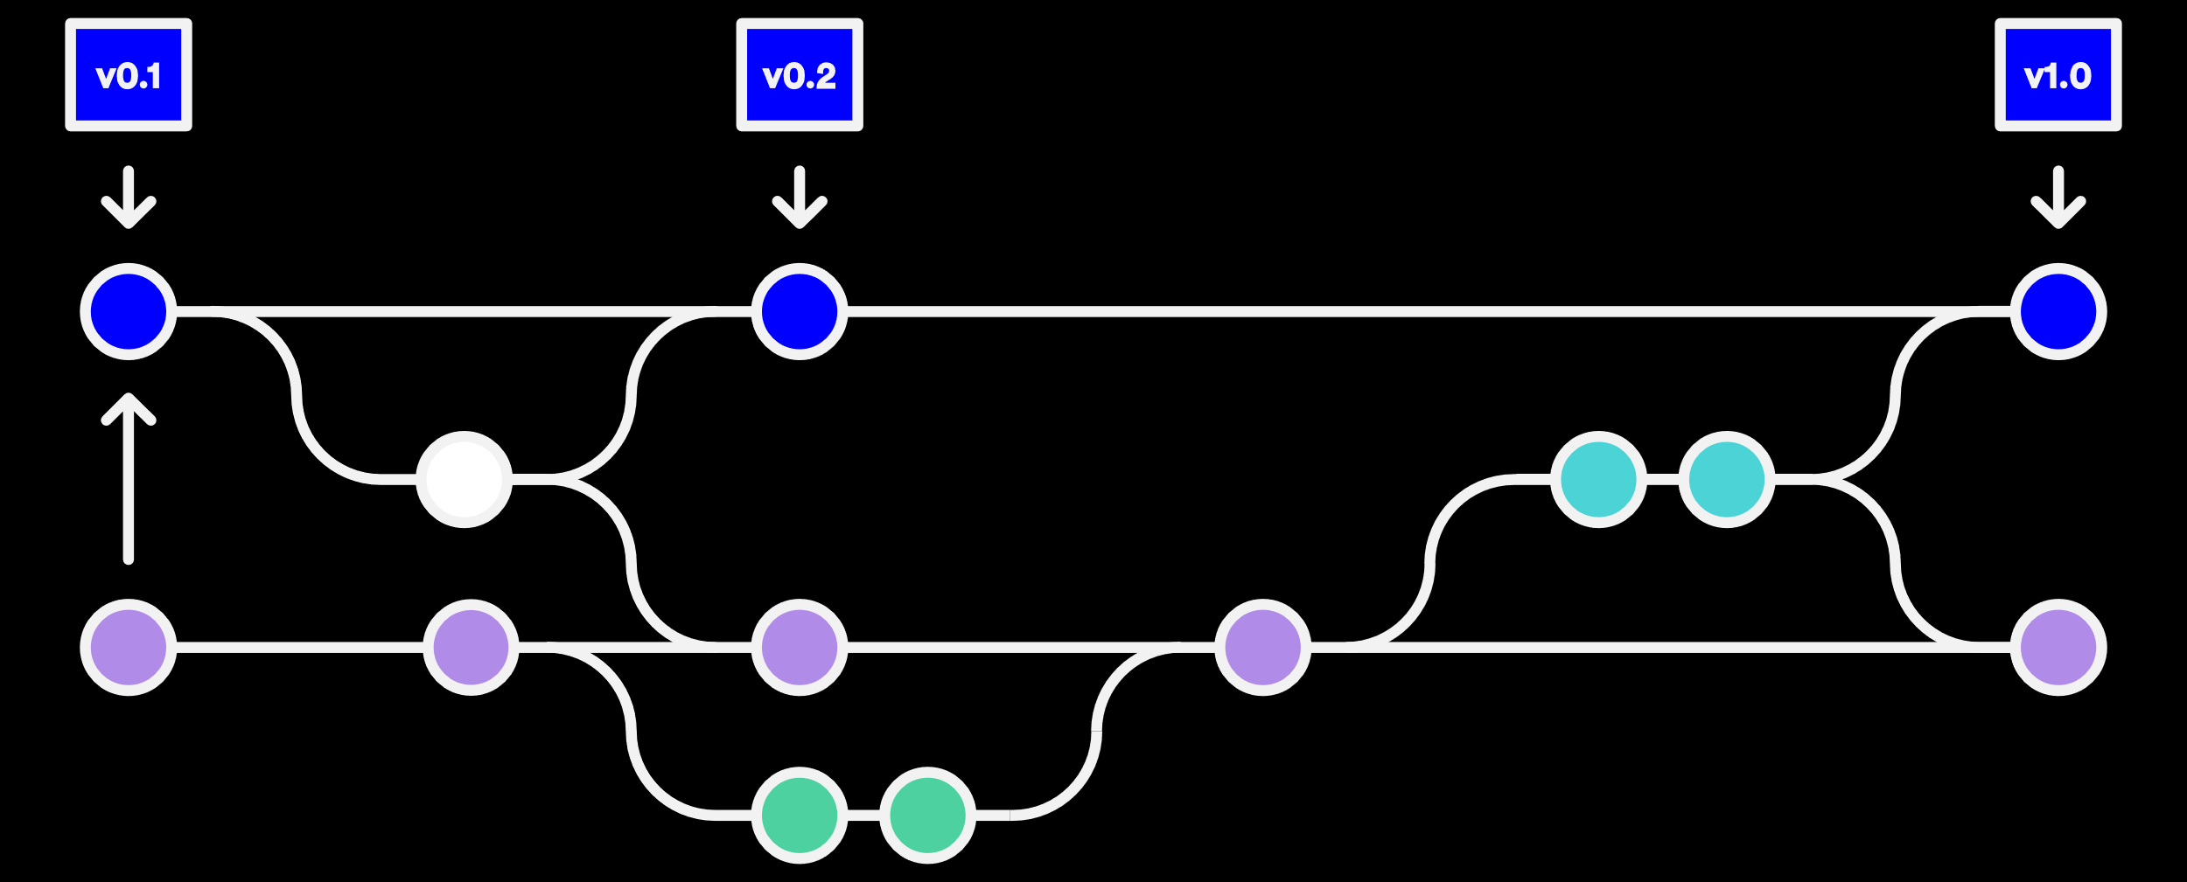
Version Control: Why?
Programmers are…
Awesome, and…
Brilliant, but…
Human, and…
Must work together.
We must plan to fail. Version control (revision control, source control) protects us from our own stupidity and faulty nature by storing changes!

Slide 6
Version Control Basics
Version control…
Is based on commits
Can have branches
Supports merging
Usually supports tags
Tag
Commit
Stable
Bugfix
Backport
Branches
Development
Experimental
Merge

Slide 7

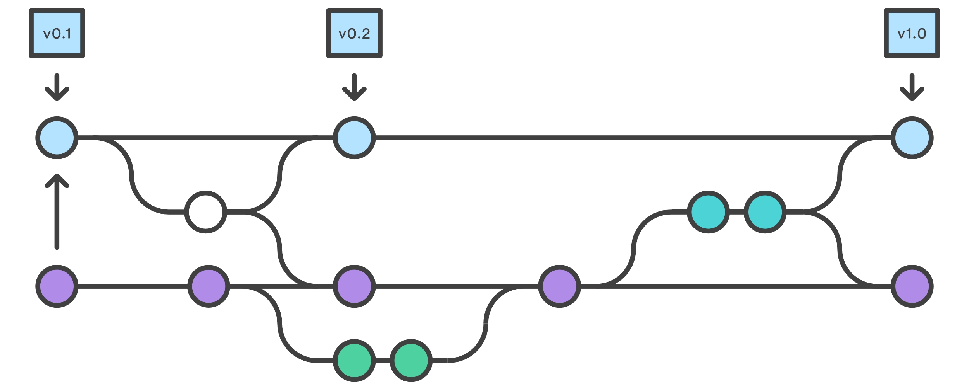

Git: Distributed Version Control
Git is a distributed version control system.
Everyone has a copy of the repository
May or may not have central repository
Commits are local until they are pushed
“Commit early and often” (low cost)

Slide 8
And now for a demonstration…
There are many tools that can be used for Git repositories.
We will support the SourceTree GUI app on Windows and MacOS.
Recommendations for command line (you’ll need one of these):
Windows 10 – Windows Subsystem for Linux (i.e., Ubuntu on Windows)
Windows 7-8 – MSYS2
Prev. Win. – …What is wrong with you?
MacOS – Type ‘git’ from a terminal.

Slide 9
Distributed VCS: Clone
A clone operation makes a copy of a repository locally.
Note: a clone does not capture any future commits!

Slide 10
Distributed VCS: Commit
Performing a commit creates a changeset from one version to another.
New Commit
changes

Slide 11
Distributed VCS: Push
A push operation pushes any changes up to a remote repository.

Slide 12
Distributed VCS: Pull
A pull operation pulls down any changes made to the remote repository.

